Slide 1
Come see for yourself how C4 can compose your diagrams

Slide 2

Shameless Self-Plug
Francis Chung
Staff Engineer with Origination (Alpha) Co-Organiser of Alt.Net & DDD-AU Meetups
Blessed and grateful to be @ Shift since April 2025.
30+ years of experience in Banking, Finance, Fintech, Startups, EdTech, SAAS & AI
Notes:
Is there ANYONE here who doesn’t know me?
And before you ask, “No, I was not on a Valentine’s day date when the photo was taken”

Slide 3

Talk Intro
01
02
Quick Intro to C4
Closer Look
03
04
Tooling for C4
Live Demo aka Live Mayhem
Notes:
So a quick rundown of the topics to be covered.

Slide 4
Why do we need C4?
“We already have well proven ways to draw diagrams”
“Even a 4 year old can understand my diagrams”
“C4 won’t be useful to me”

Slide 5


Slide 6

Let’s have a look at some diagrams
Can you tell me what the following diagrams are trying to describe?
6
Notes:
This family is smiling because they are looking at thoes beautiful C4 diagrams.
They’re going to be crying by the end of the diagrams I’m about to show you
Please COMMENT in the chat FREE STYLE some of the thoughts that comes to mind

Slide 7
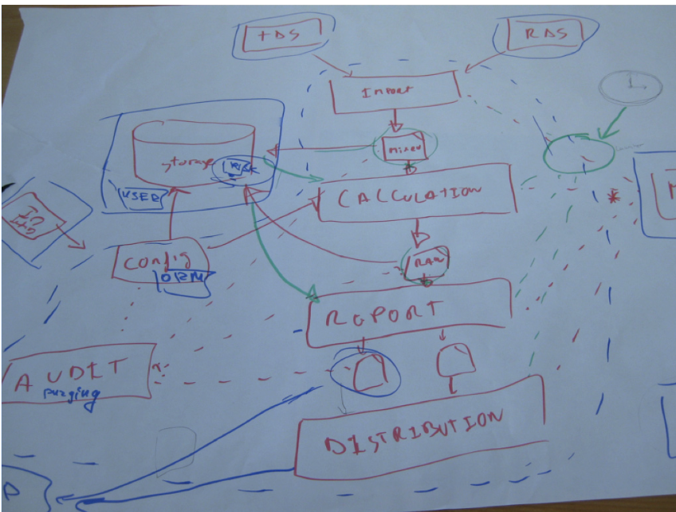
Notes:
These are some examples for the C4 Book I’ll tell you about later.
Feel free to comment in the chat what’s wrong with this diagram
Did a 6 year old draw this?
What are the dotted lines?
Big ball of muddy mess
What do the coloured lines mean?
What are those unlabelled circles?
What are those unlabelled squares underneath report?
What is TDS? What is RDS? Hands up who’s guilty of drawing something like this? Don’t be shy now

Slide 8
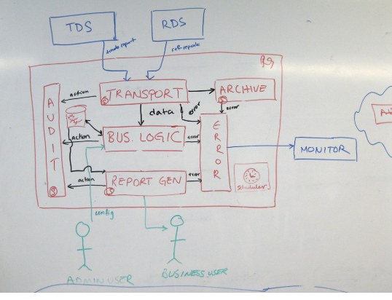
Notes:
This diagram is a bit better, but still have issues
What does action mean? What type of errors? Are they all the same error? Who ever has ever diagrammed an error component separately? Are they generating that many errors?
What does the red context border mean? What system does it represent? What Technology do you think they are using underneath?

Slide 9
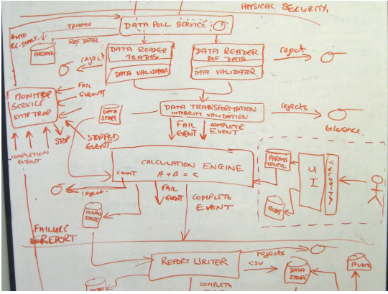
Notes:
More complete diagram
Better labelling, but still incomplete
What are those circle with line symbols on top right?
There’s still no title?
What does “A + B = C” mean?

Slide 10
What’s wrong with the previous diagrams?

Slide 11
What’s wrong with the previous diagrams?
No consistent methodology
1
Everyone seems to have their own standard of drawing diagrams
Notes:
So this is my top 3 reasons for what’s wrong with the previous diagrams
The last item will come as a bit of surprise, but traditionally System Diagrams was only used by Developers. Why should this be the case, especially in an era where there’s more collaboration between different teams (Product, Business etc) So is there a way to address the above issues?

Slide 12
What’s wrong with the previous diagrams?
No consistent methodology
A lot of context is missing
1
Everyone seems to have their own standard of drawing diagrams
2
Quite often, the author seems to assume the audience knows a lot of missing context that is not obvious
Notes:
So this is my top 3 reasons for what’s wrong with the previous diagrams
The last item will come as a bit of surprise, but traditionally System Diagrams was only used by Developers. Why should this be the case, especially in an era where there’s more collaboration between different teams (Product, Business etc) So is there a way to address the above issues?

Slide 13
What’s wrong with the previous diagrams?
No consistent methodology
A lot of context is missing
Intended audience could be bigger
1
Everyone seems to have their own standard of drawing diagrams
2
Quite often, the author seems to assume the audience knows a lot of missing context that is not obvious
3
Why should System Diagrams only be used by Developers?
Notes:
So this is my top 3 reasons for what’s wrong with the previous diagrams
The last item will come as a bit of surprise, but traditionally System Diagrams was only used by Developers. Why should this be the case, especially in an era where there’s more collaboration between different teams (Product, Business etc) So is there a way to address the above issues?

Slide 14
Common Problems with System Diagrams
• Levels of abstraction are mixed.
• Notation (e.g. colour coding, shapes, etc) is not explained or is inconsistent.
• The purpose and meaning of elements is ambiguous.
• Relationships between elements are missing or ambiguous.
Notes:
The C4 book mentions the following points
C4 Gag Alert
So …. “What is C4 then?”

Slide 15
Common Problems with System Diagrams
• Levels of abstraction are mixed.
• Notation (e.g. colour coding, shapes, etc) is not explained or is inconsistent.
• The purpose and meaning of elements is ambiguous.
• Relationships between elements are missing or ambiguous.
• Generic terms such as “business logic” are used.
• Technology choices (or options, if doing up front design) are omitted.
• Too much or too little detail.
• No context or a logical starting point.
Notes:
The C4 book mentions the following points
C4 Gag Alert
So …. “What is C4 then?”

Slide 16
So what is C4?
Notes:
I feel like I’m in a Military Expo trying to flog off North Korean Ammunition
C4 Gag Alert
So …. “What is C4 then?”

Slide 17
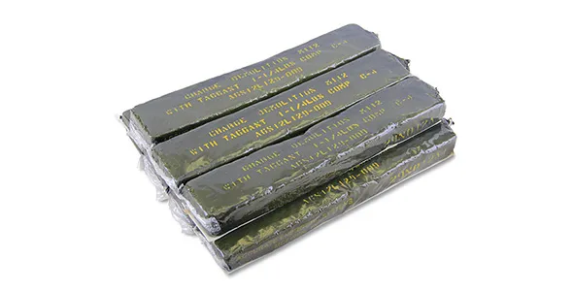
So what is C4?
Notes:
Whoops Wrong Slide …. I’m also moonlighting as a Salesperson for North Korean Mining Equipment
C4 Gag Alert
So …. “What is C4 then?”

Slide 18

What is C4 (really)?
Wikipedia : “The C4 model is a lean graphical notation technique for modelling the architecture of software systems.^{[1][2]} It is based on a structural decomposition of a system into containers and components”
My Take : “C4 model is an attempt to address deficiencies with traditional diagramming techniques by incorporating an ubiquitous vocabulary of well defined notation and components, to describe a system using multiple diagrams that represent different levels of abstractions and details”
Invented by Simon Brown, Author, Software Architect & Frequent Flyer from the UK
Notes:
The C4 book mentions the following points
C4 Gag Alert
So …. “What is C4 then?”

Slide 19
What C4 isn’t
It is not intended to replace your favourite beloved diagrams like
UML
Entity Relationship diagrams (ERD)
Sequence diagrams
Infrastructure diagrams
Deployment diagrams
Business Process Model Notation (BPMN)
etc etc

Slide 20
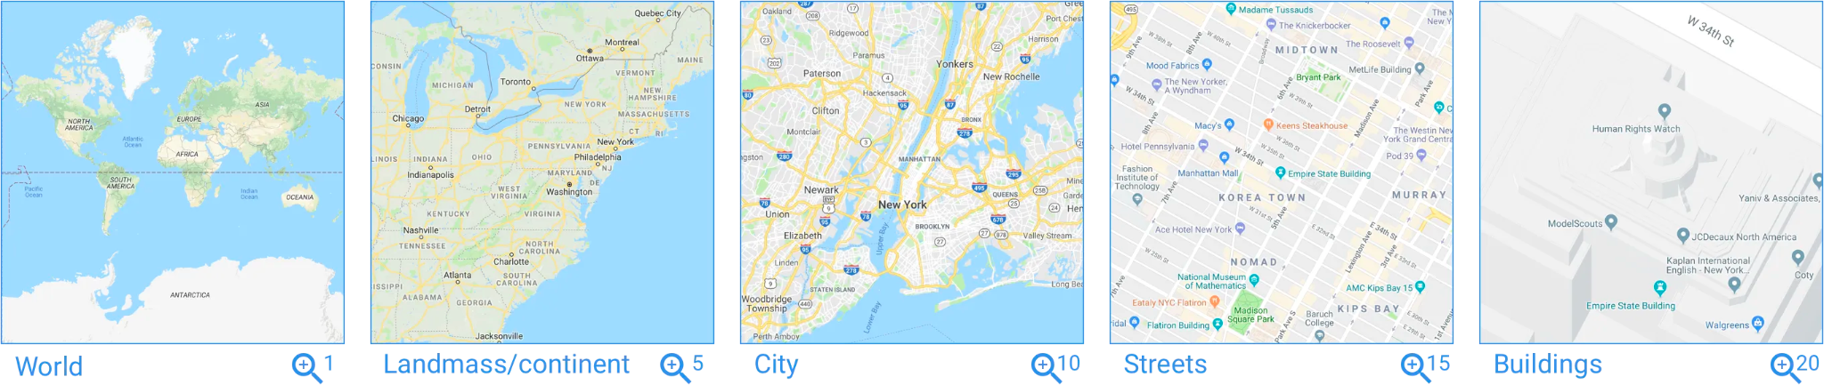
C4 in a nutshell (TLDR)
Think if Google Maps were a system diagram with different zoom levels
Notes:
So this is another definition of C4 that might be the easiest to grasp, especially if you’re a visual learner.
<Slide>
Each “Map” shows different level of details and represent different level of abstraction(s)
…..
I noticed last night that the last map has zoomed into Korea Town.
Don’t get any ideas, that’s not where my sales pitch is happening!

Slide 21
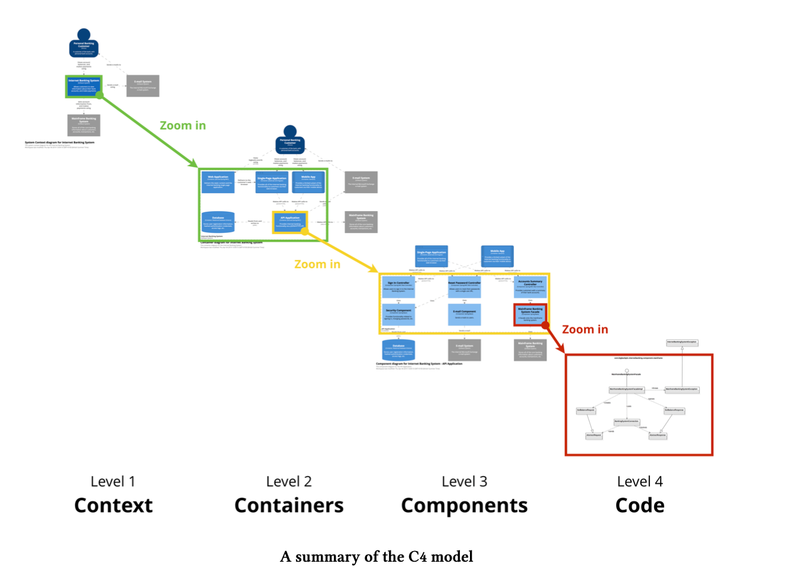
So what are the 4 Cs in C4?
Notes:
SO I’m going to use the an internet banking system as an example.
It’s one I believe that most of the audience might be some what familiar with.
It’s also the same example Simon’s book uses (Plagarism alert!)
<Slide>
Don’t worry if you can’t see the details of these slides.
We’ll be taking a closer look shortly

Slide 22
But before we dive deeper …. some Vocabulary first
Person
Software System
Container
Component
Notes:
“... so you know what I’m talking about. Perhaps t
Person - Any User that is interacting with your System
Software System - Can either be your system or external system. External Systems are outside the scope of your own Systems. Systems that you have no responsibility or ownership of
Container - It is not a Docker Container. More on this later. A "container" is something like a web application, mobile app, desktop application, database, file system, etc. Essentially, a container is a separately deployable unit that executes code or stores data
Component - A functional unit within the Container, such as modules, set of classes or a set of interfaces. These can’t be deployed independently, unlike a container.

Slide 23
… and some key features of C4
A Name !
Description - Because Names aren’t enough, you perhaps need context
Arrows have descriptions too
A Title!
Notes:
<Slide>
A lot of these features were missing in lots of places in the diagrams I’ve shown you before

Slide 24
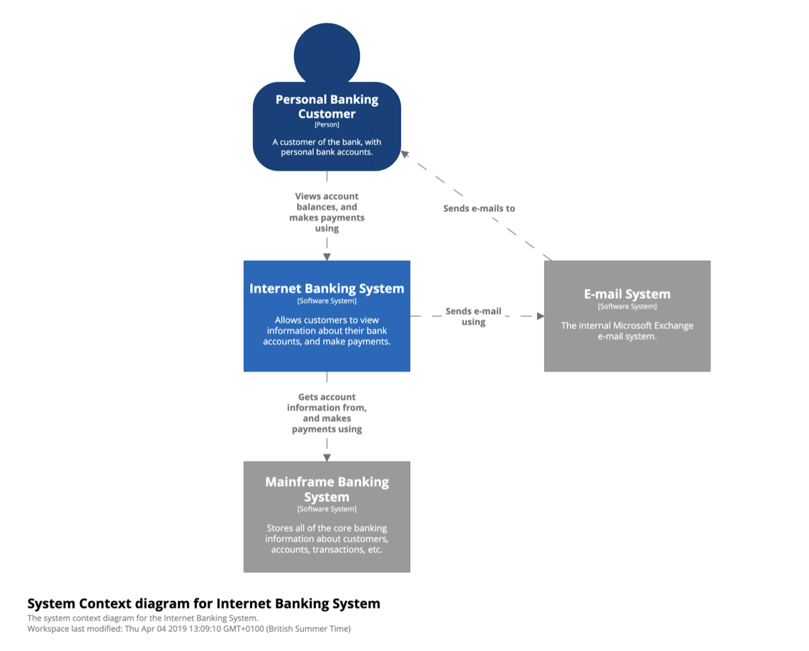
L1 - Context (or System Context)
Notes:
Example from the book, imagine we’re the internet banking system team
The example here is to describe your system from a very zoomed out level if you like, and describing you system holistically.
The focus is on People and Software Systems that your system interacts with
The focus is NOT on technology, protocol and other low level tech details
Perfect place to show non technical people to open up discussions

Slide 25
L1 - Context Level Key Points
The focus is on People and Software Systems that your system interacts with
The focus is NOT on technology, protocol and other low level tech details
Perfect place to show non technical people to open up discussions
Notes:
L1 usually only have people and other software systems.

Slide 26
L1 - Context (or System Context)
Notes:
I want to you to take a look at the diagrams, specifically think about how simple it is.
Perhaps when we used to doodles as diagrams, this may be a jarring experience for you.
An unease might be creeping in, like sensing a cat burglar trying to steal your bitcoin wallet (All these mining jokes!)
Some of you might be wondering what’s the point of such simple diagram?
The focus is on People and Software Systems that your system interacts with
The focus is NOT on technology, protocol and other low level tech details
Perfect place to show non technical people to open up discussions

Slide 27
L1 - What is the point of diagrams simple as L1?
Simplicity actually is the key feature here.
All context and scope of the system is explicit, so there are NO assumptions.
It shows what is being added (from a high-level) to an existing environment
It’s a high-level diagram that technical and non-technical people can use as a starting point for discussions.
It provides a starting point for identifying who you potentially need to go and talk to as far as understanding inter-system interfaces is concerned.
Notes:
<Slide>
Is there any non technical people out there who didn’t understand this diagram?
That last 2 points is something I’ve come across a lot

Slide 28
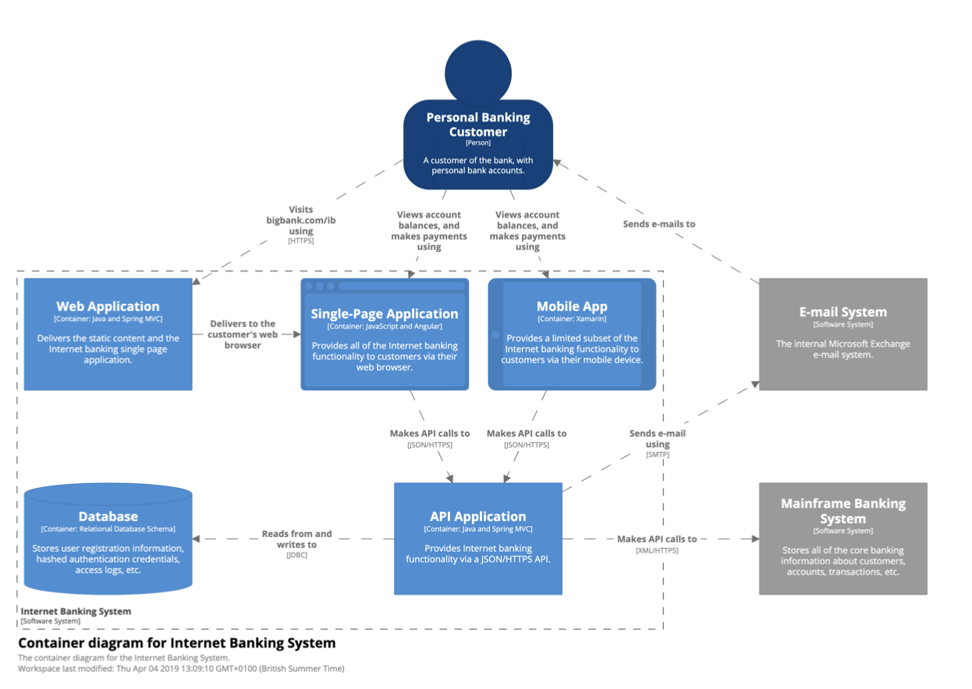
L2 - Container
Notes:
A "container" is something like a web application, mobile app, desktop application, database, file system, etc. Essentially, a container is a separately deployable unit that executes code or stores data
Note Simon Brown claims he started using Container () before Docker was invented ().
Even though Container is now more associated with Docker, he refuses to budge.
I have to agree with him on this one.
(I have your back, Simon!)
Note the increase in detail here
For example the Person now has a lot more arrows describing the different interactions with different containers within the system

Slide 29
L2 - Container Level Key Points
It’s a high-level technology focussed diagram that is useful for technical people like Devs, Architects, Support etc
It shows the major technology choices, how they are used, and how containers communicate with each other.
Notes:
As you drilldown, you’ll notice it starts to get a little bit more technology focused.
It may be of use to non IT/engineering people who knows a lot about technology (Basically your technical BAs/Producrt managers etc)

Slide 30
L2 - Container
Notes:
Now drilldown into the API Application
A "container" is something like a web application, mobile app, desktop application, database, file system, etc. Essentially, a container is a separately deployable unit that executes code or stores data
Note Simon Brown stared using Container () before Docker was invented ()
Note the increase in detail here
For example the Person now has a lot more arrows describing the different interactions with different containers within the system

Slide 31
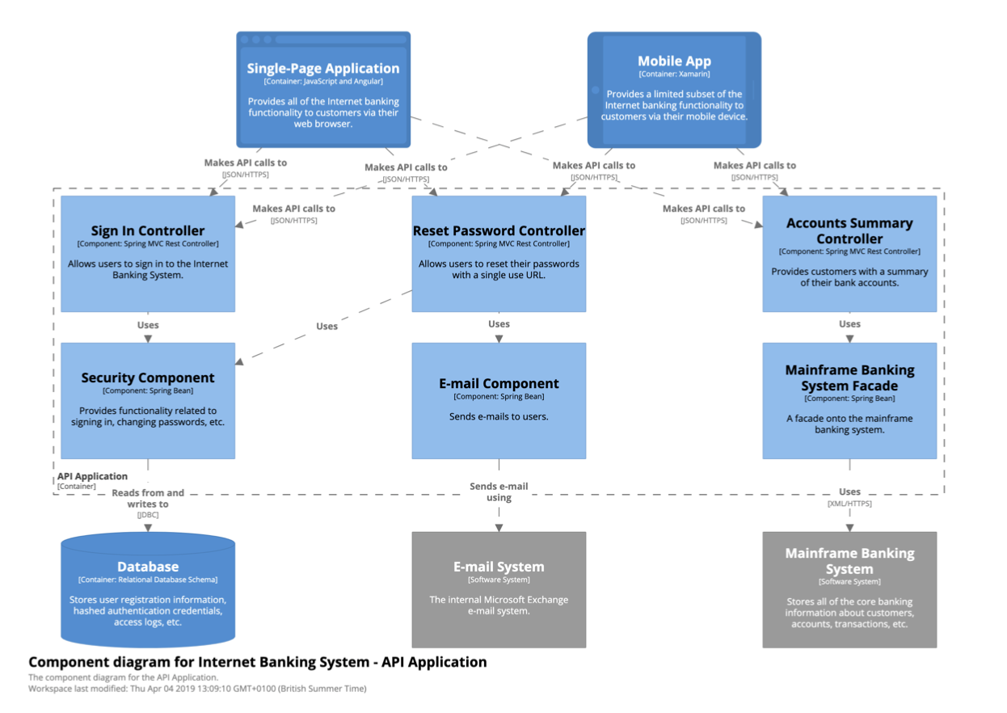
L3 - Component
Notes:
Component definition -
A functional unit within the Container, such as modules, set of classes or a set of interfaces. These can’t be deployed independently, unlike a container.
This is what people usually draw when they’re asked to draw a System Diagram
Name: The name of the component.
Technology: The implementation technology for the component (e.g. Plain Old [Java|C#|Ruby|etc] Object, Enterprise JavaBean, Windows Communication Founda- tion service, etc).
Description:Ashortdescriptionofthecomponent,usuallyabriefsentencedescribing the component’s responsibilities.
Abstraction element representing the internals of the container of such modules or a set of interfaces that can be grouped as a functional unit. In Java or C# terms, they can be seen as a set of classes implemented for interfaces or packages. They differ from containers as these cannot be deployed independently.

Slide 32
L3 - Component Level Key Points
It shows the high-level decomposition of a container into components, each with distinct responsibilities.
It shows where there are relationships and dependencies between components.
It provides a high-level summary of the implementation details, including any frameworks or libraries being used.
If the components shown on the diagram can be explicitly mapped to the code, you have a good way to really understand the structure of a codebase.
C4 diagrams are great for onboarding new technical staff, arguably L3 the most useful to some (and L2 to others)
Many adopt is an optional level of detail for long-lived documentation, because of the potentially high degree of effort involved in creating the diagrams, and keeping them up to date
Notes:
L3 is where you’re decomposing some of your containers to the component level (major building blocks if you like of your application)
We’re seeing some of the interactions amd dependencies on it.
If there’s a good mapping between the component and code for example, then you have a really good starting point for newbies to understand the structure of your codebase

Slide 33
L3 - Component
Notes:
Component definition -
A functional unit within the Container, such as modules, set of classes or a set of interfaces. These can’t be deployed independently, unlike a container.
This is what people usually draw when they’re asked to draw a System Diagram
Name: The name of the component.
Technology: The implementation technology for the component (e.g. Plain Old [Java|C#|Ruby|etc] Object, Enterprise JavaBean, Windows Communication Founda- tion service, etc).
Description:Ashortdescriptionofthecomponent,usuallyabriefsentencedescribing the component’s responsibilities.
Abstraction element representing the internals of the container of such modules or a set of interfaces that can be grouped as a functional unit. In Java or C# terms, they can be seen as a set of classes implemented for interfaces or packages. They differ from containers as these cannot be deployed independently.

Slide 34
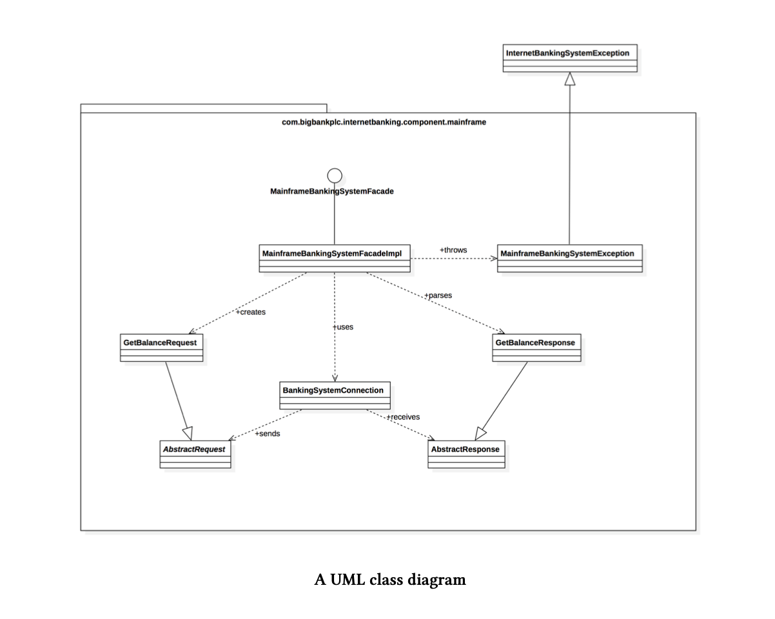
L4 - Code
Notes:
So earlier, I may have taken the piss out of UML, and that should have been a hint of things to come as …..
For L4, Simon actually didn’t invent anything for L4, the code level.
He recommends using traditional methods as such as UML or Class Diagrams.
Also he recommends using a tool rather than hand generating it :)
Is it just me or are you feeling a little bit ripped off here, bit of bait and switch going on.
Perhaps I should start a lobby saying this should be called C3+1 or C3 + U or C3 + UML
(Maybe I dont have your back on this part, Simon!)

Slide 35
L4 - Code Keypoints
Map the high-level, coarse-grained components into real-world code elements.
It helps to bridge the software architecture and the code, which are very different.
Please use a tool to generate this
Can get very messy very quickly, so limit your scope when generating
Notes:
<slides>
…..
Which leads ius to the next section ….

Slide 36

Tooling
You weren’t thinking of drawing it by hand, were you?
36

Slide 37
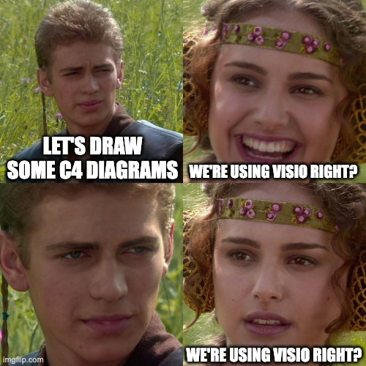
Notes:
“For the love of god ….. please don’t use Visio to draw C4 diagrams”

Slide 38
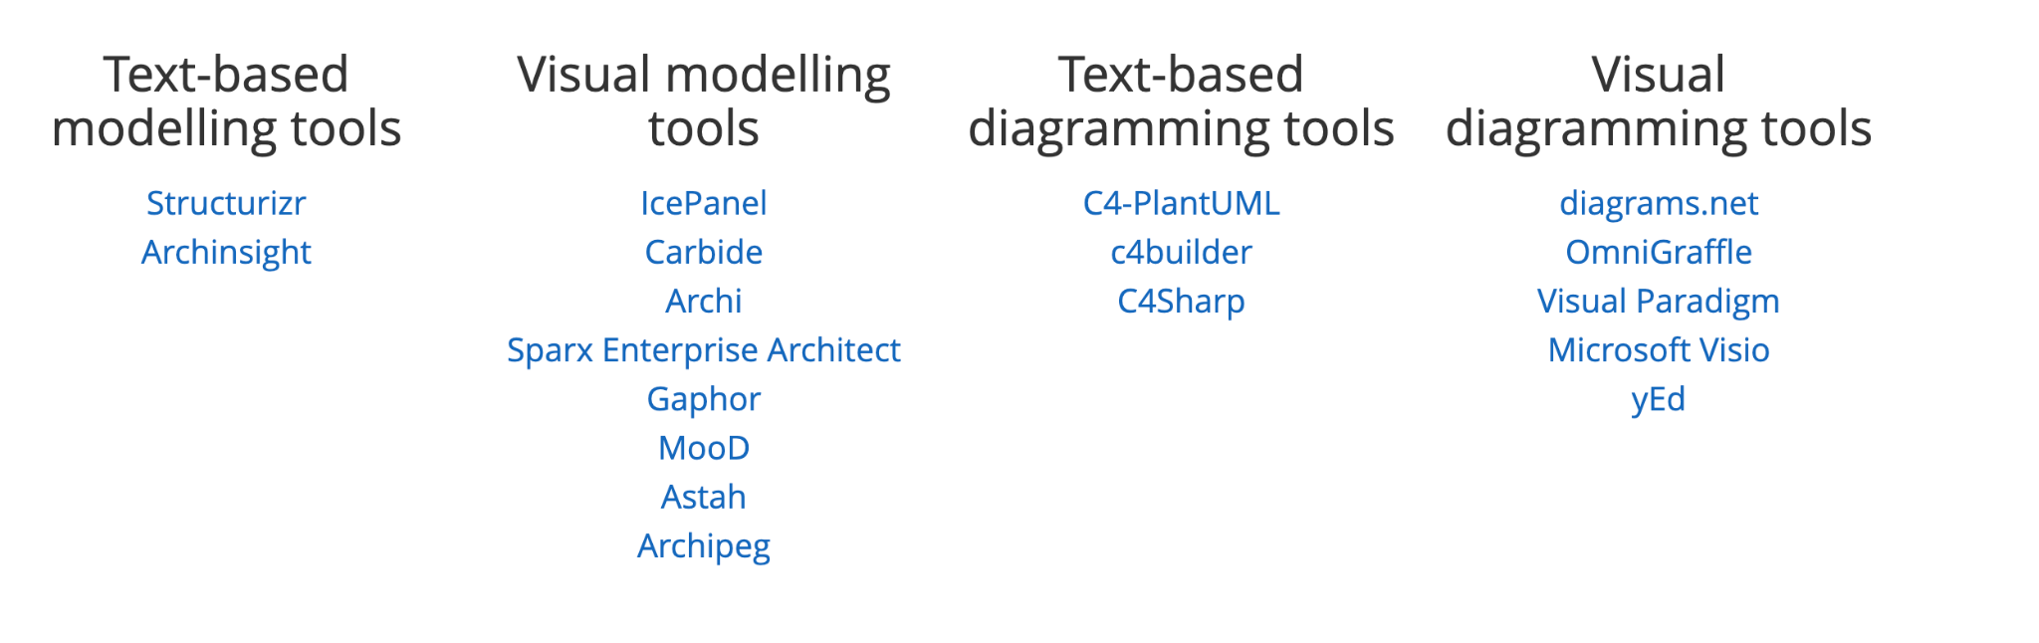
List of Tools (from c4model.com)

Slide 39
List of Tools (evaluated at FreshBooks)
Visio (Unfriend me now)
Diagrams.net (Formerly Draw.io)
PlantUML
Structurizr
Notes:
PlantUML and Structurizr - Semantic

Slide 40
List of Tools (evaluated at FreshBooks)
Visio (Unfriend me now)
Diagrams.net (Formerly Draw.io)
PlantUML
Structurizr ← My Recommendation
Notes:
PlantUML and Structurizr - Semantic

Slide 41
Why Structurizr
Built by the author of C4
Simon Brown
Modelling Diagram as Code
Free and recently Open Sourced
1
It’s a tool that is built from ground up with C4 in mind
2
Easier to maintain and track if your model changes in the future.
3
We all love free stuff right?
Notes:
No Tool can say that they have the C4 Model as a first class citizen
Especially in Alt.NET, we love FREE
The last item will come as a bit of surprise, but traditionally System Diagrams was only used by Developers. Why should this be the case, especially in an era where there’s more collaboration between different teams (Product, Business etc) So is there a way to address the above issues?

Slide 42
Resources
C4
C4 Website
https://c4model.com/
Leanpub
The C4 model for visualising software architecture
https://leanpub.com/visualising-software-architecture
Structurizr
https://github.com/structurizr
https://structurizr.com/
Cheat Sheet
https://static.codingthearchitecture.com/c4.pdf
Notes:
“For those who don’t know what Leanpub is, (No it’s not a pub where they only allow Skinny People in at the door), it’s an independent online bookstore. That’s a really good business model, only letting skinny people in”
“Pro Tip : Check to see if a book is 100% written before you buy it!”

Slide 43
References / Bibliography
https://c4model.com/
https://leanpub.com/visualising-software-architecture
https://medium.com/google-design/google-maps-cb0326d165f5

Slide 44
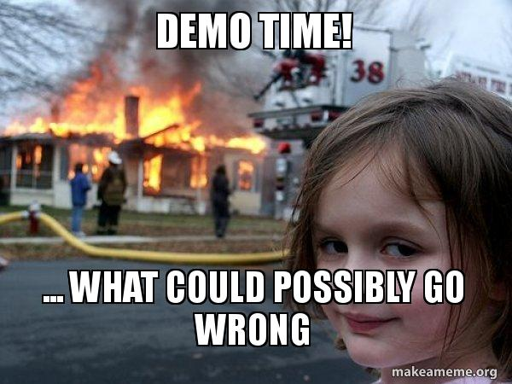
Notes:
This was also the response from O’Reilly when I sent them a 2nd book proposal
Actually, I forgot to pray to the Demo Gods this morning, so the demo shit with hit the fan”

Slide 45

Thank You
Don’t be afraid to reach out for questions or connect with me on Linkedin
Notes:
Joke about maybe being afraid of linking up on Linkedin

Slide 46
anna.popyuk@freshbooks.com
francis.chung@freshbooks.com
Notes:
I work for a company called FreshBooks.
If anyone is interested in trialling our Accounting & Invoicing software, I have arranged an extended trial.
Please hit me up

Slide 47
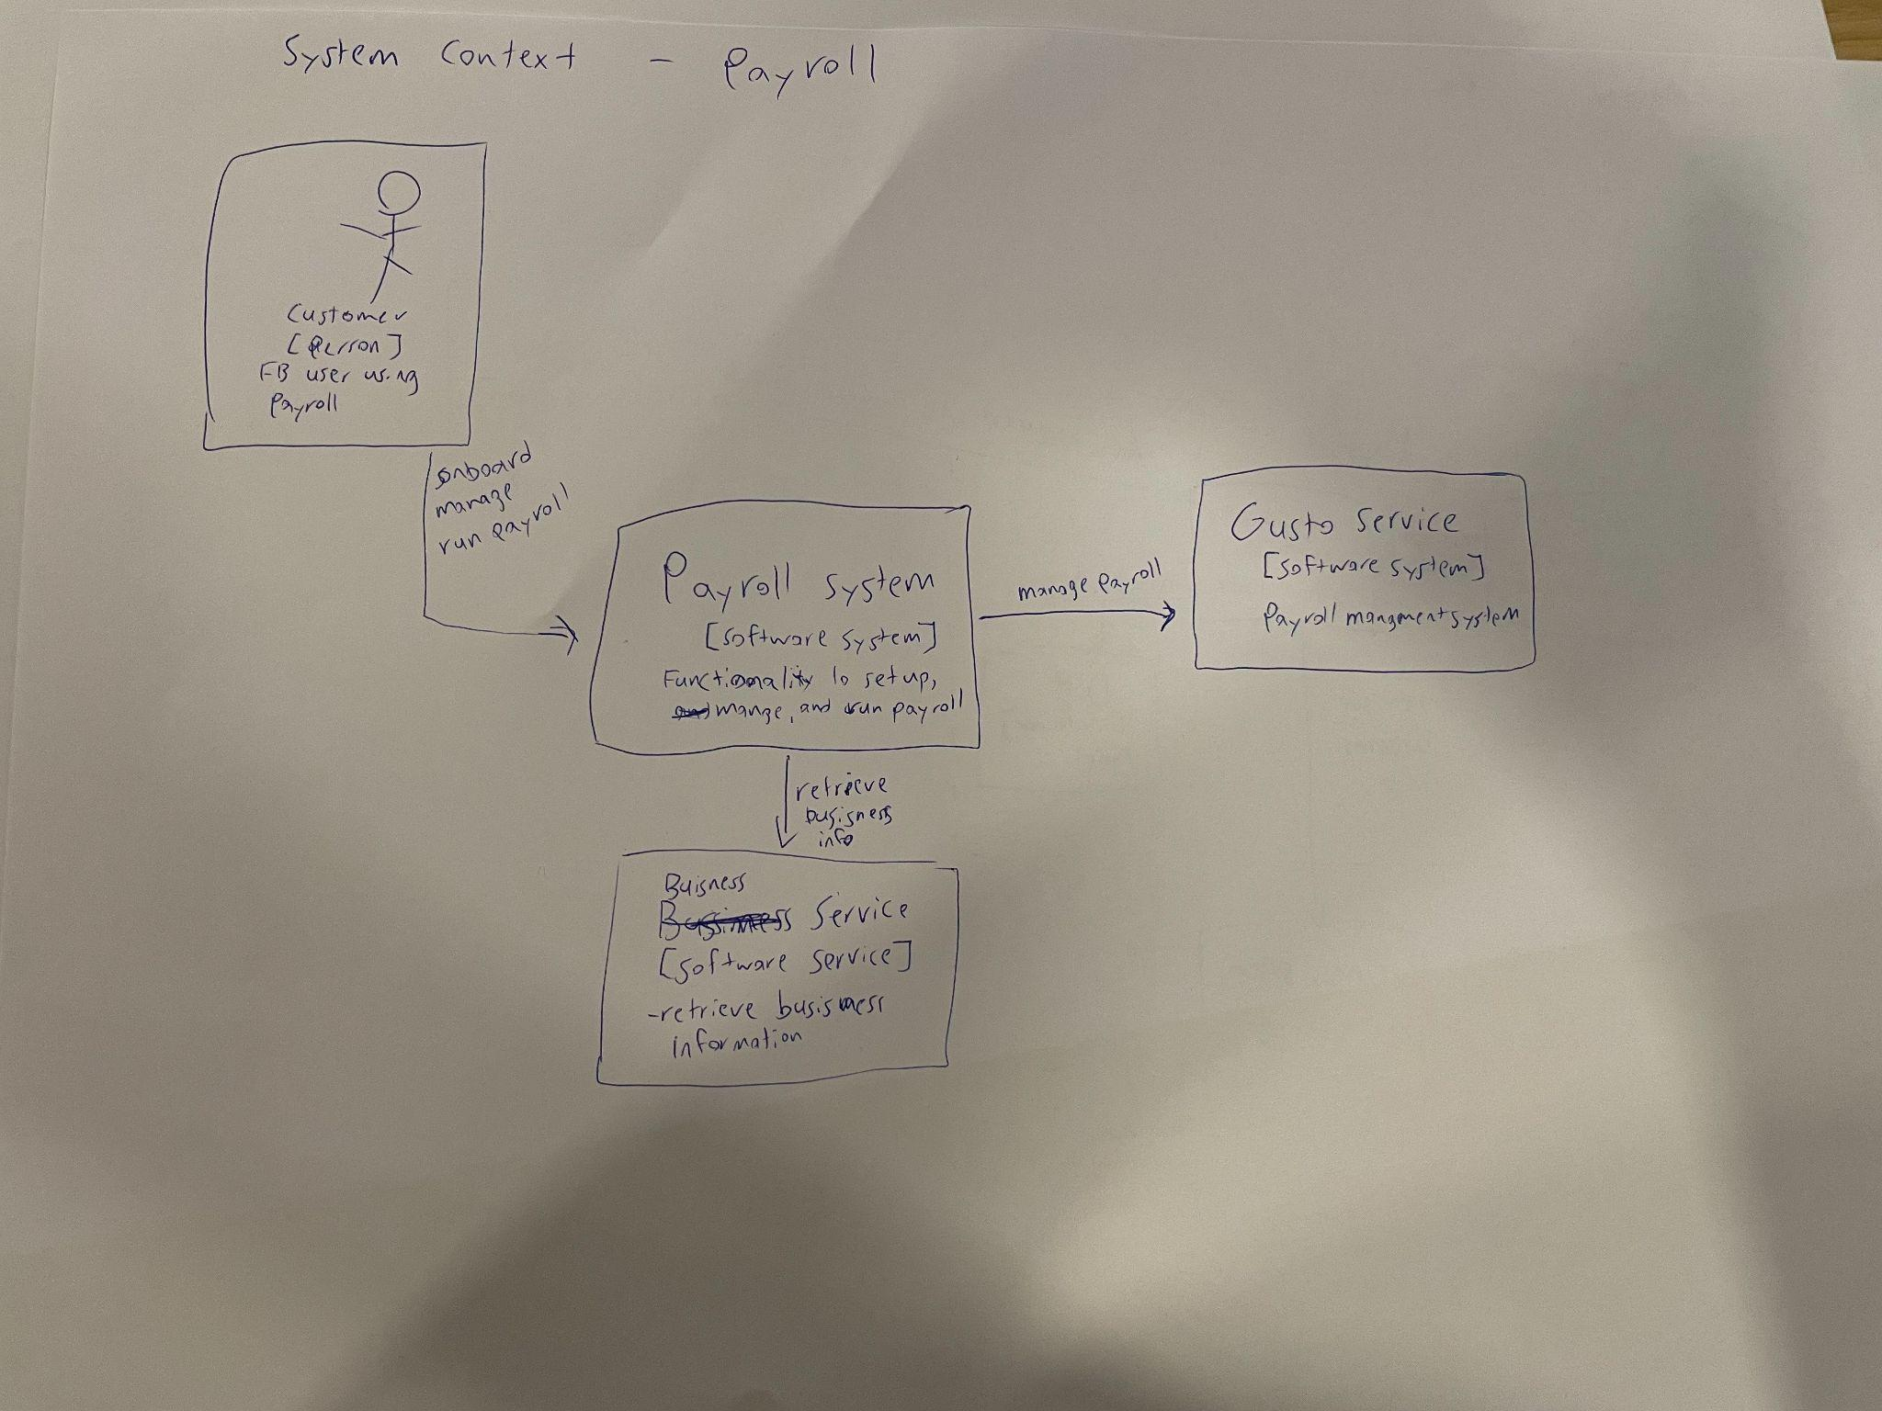
Notes:
So I want to go through a real life example that I went through at work.
Some background.
We’re building a Payroll feature for our platform.
During Simon’s workshop, we were tasked to come up with some hand drawn diagrams to describe a system within our domain

Slide 48
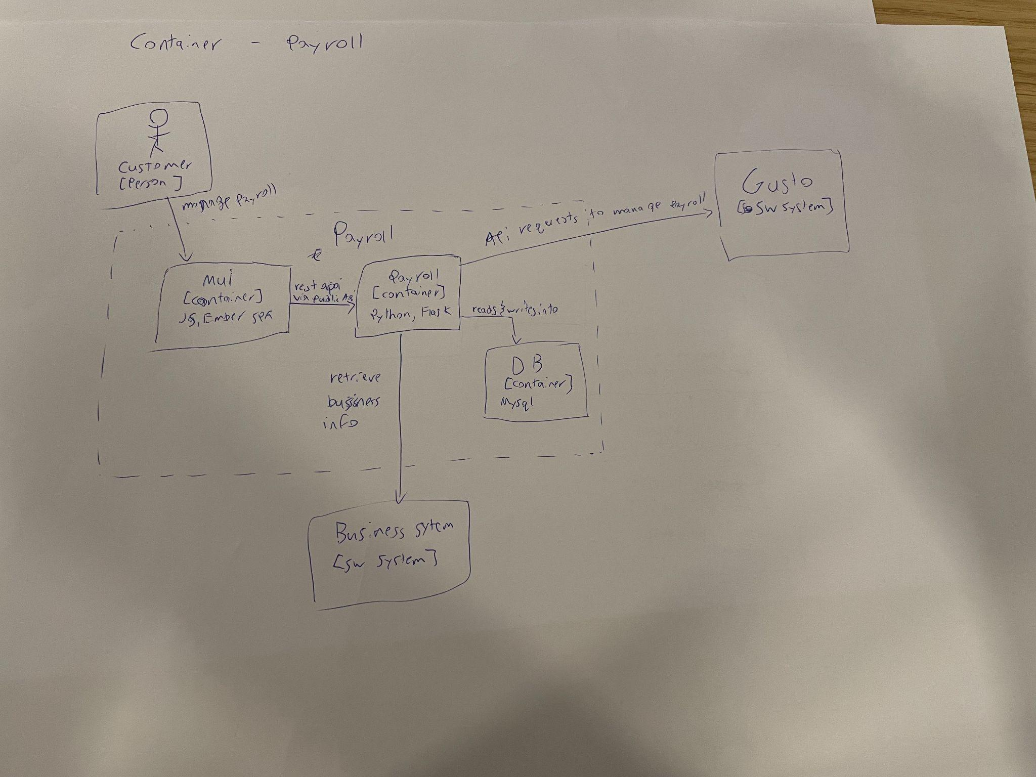
Notes:
So I want to go through a real life example that I went through at work.
Some background.
We’re building a Payroll feature for our platform.
During Simon’s workshop, we were tasked to come up with some hand drawn diagrams to describe a system within our domain

Slide 49
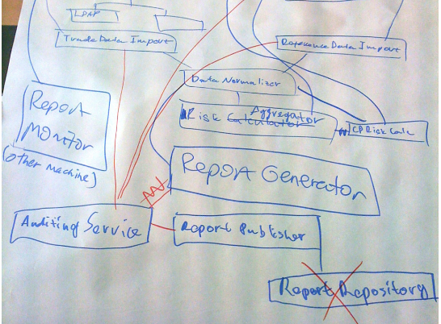
Notes:
What do the lines mean? Which direction is it heading?
No title? What does this diagram represent?
What do the different coloured lines represent?
What’s RepoA Generation?

